Slide 1
Chapter 8
Numerical Differentiation

Slide 2
Core Topics
(i) Finite Difference Approximation of the Derivative (8.2).
(ii) Finite Difference using the Taylor Series Expansion (8.3) (iii) Summary of Finite Difference Formulas for Numerical Differentiation (8.4).
(iv) Differentiation Formulas using Lagrange Polynomials (8.5)
(v) Differentiation using Curve Fitting (8.6)
(vi) Use of MATLAB built-in Functions for Numerical Differentiation (8.7).
(vii) Richardson’s Extrapolation (8.8)
(viii) Error in Numerical Differentiation (8.9) (ix) Numerical Partial Differentiation (8.10)

Slide 3
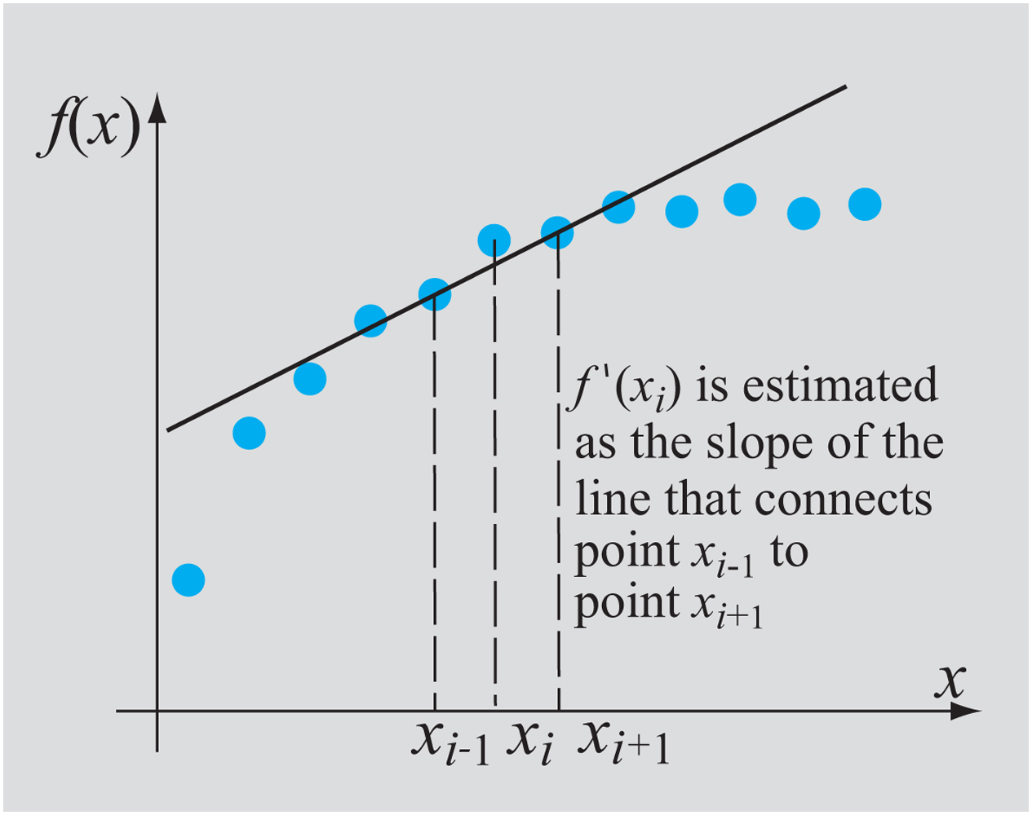
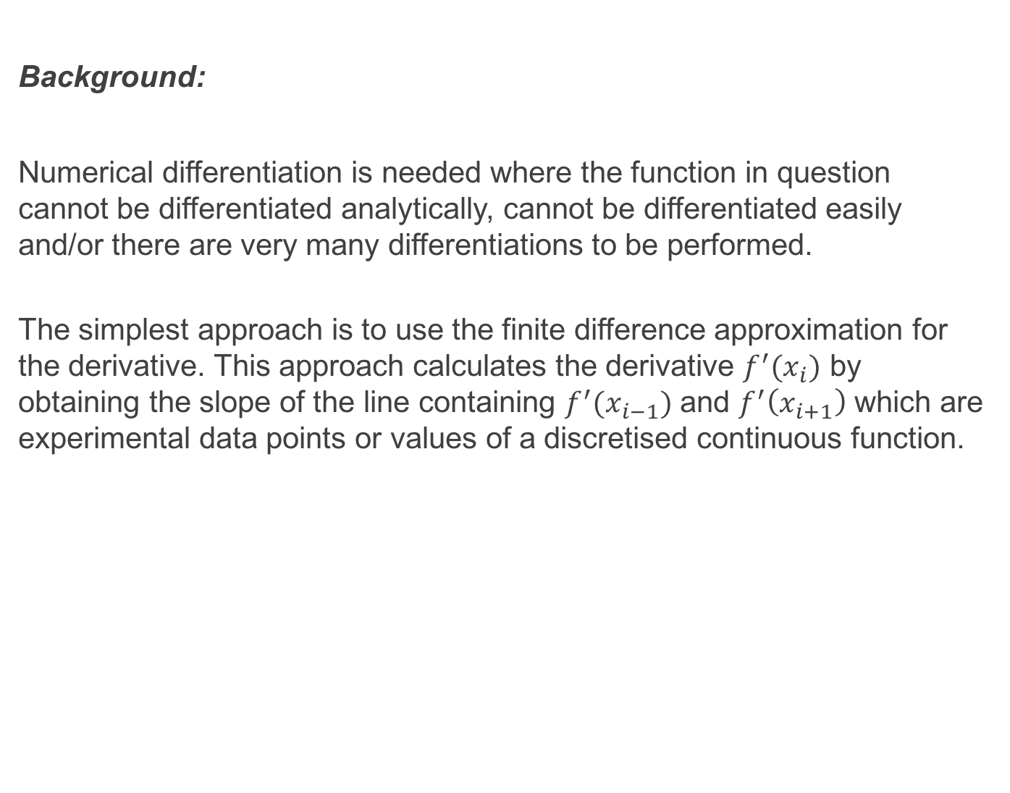
Background:
Numerical differentiation is needed where the function in question cannot be differentiated analytically, cannot be differentiated easily and/or there are very many differentiations to be performed.
The simplest approach is to use the finite difference approximation for the derivative. This approach calculates the derivative $f^{′}(x_{i})$ by obtaining the slope of the line containing $f^{′}(x_{i−1})$ and $f^{′}\left(x_{i+1}\right)$ which are experimental data points or values of a discretised continuous function.

Slide 4
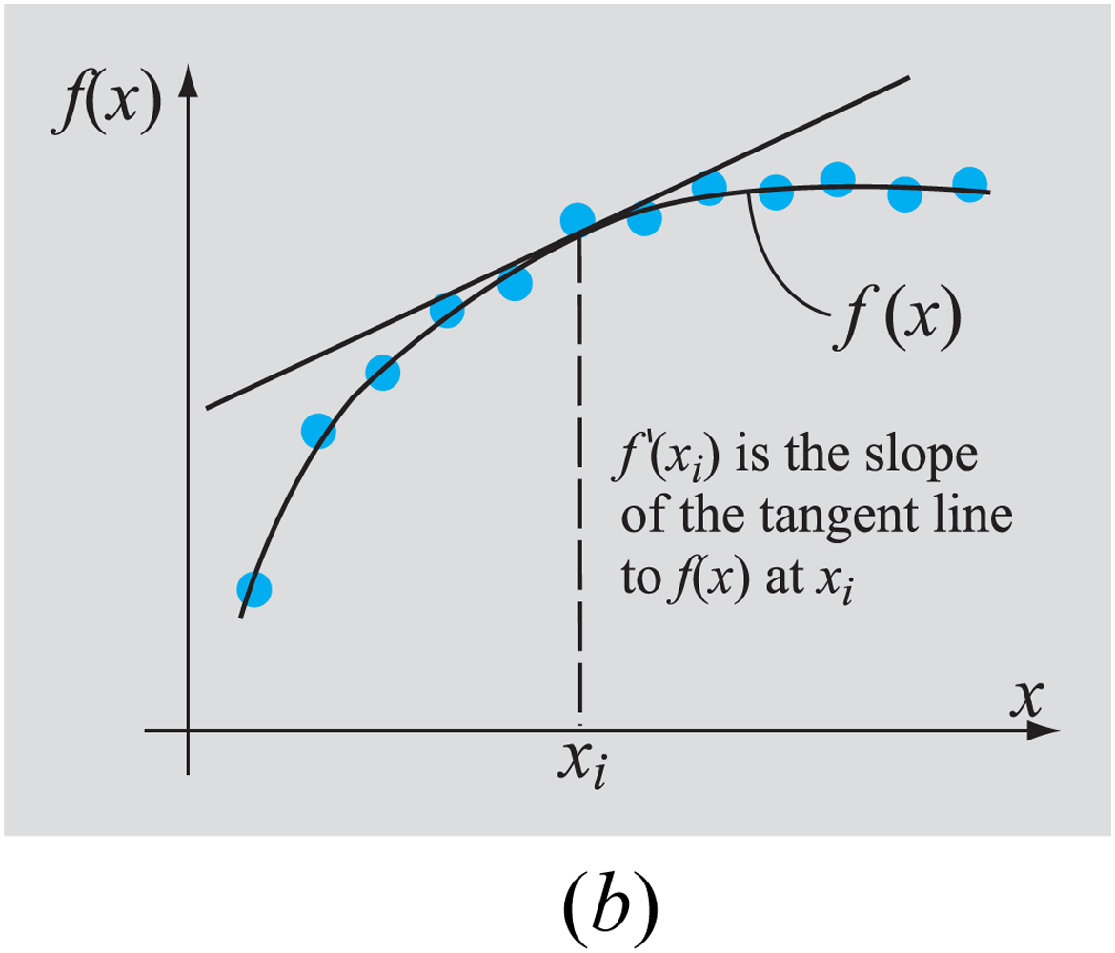
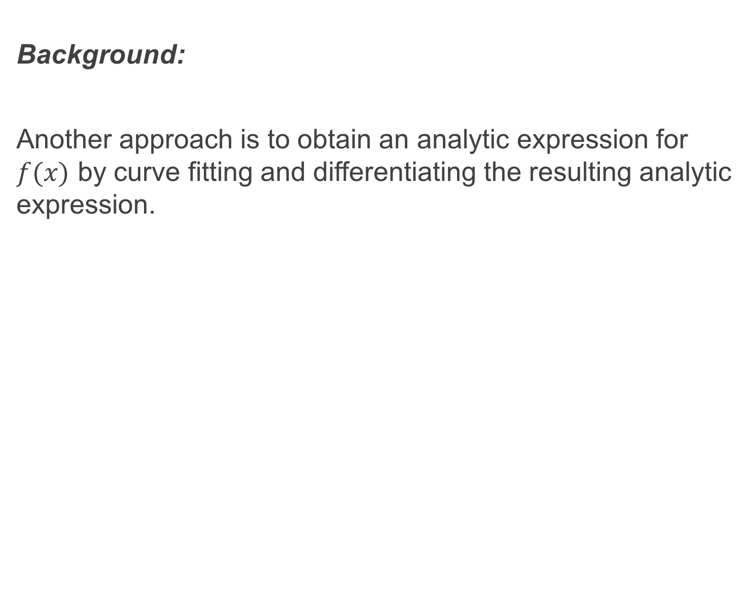
Background:
Another approach is to obtain an analytic expression for $f(x)$ by curve fitting and differentiating the resulting analytic expression.

Slide 5
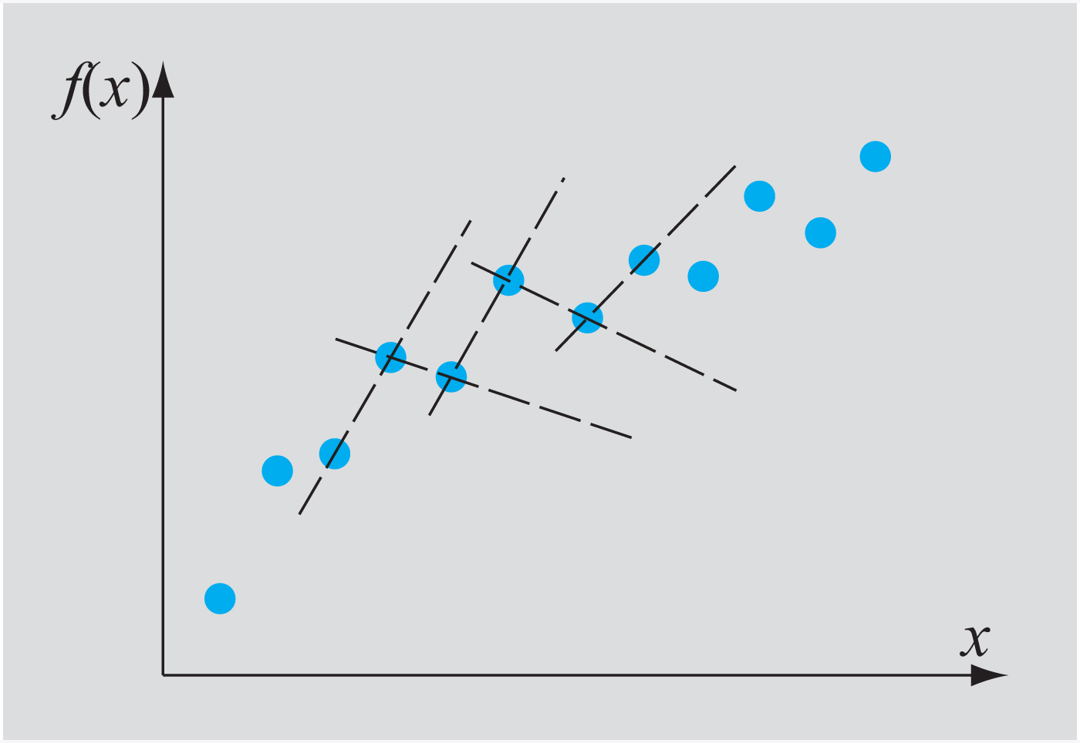
Background:
Oftentimes there is a lot of scatter in experimental data which means that there can be large inaccuracies in differentiation using the finite difference method. This can be remedied by using higher order finite difference approximations which we will see later.

Slide 6
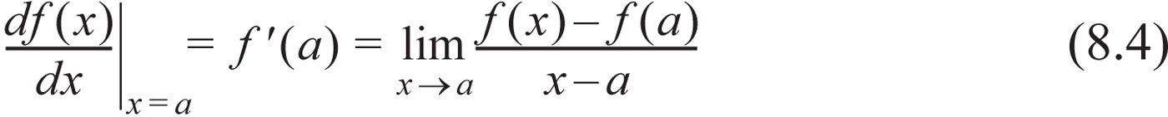
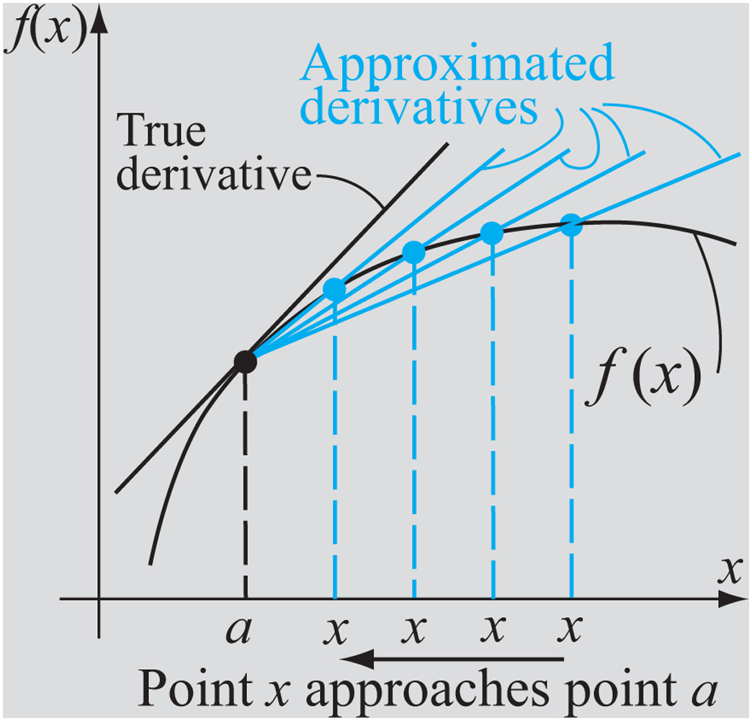
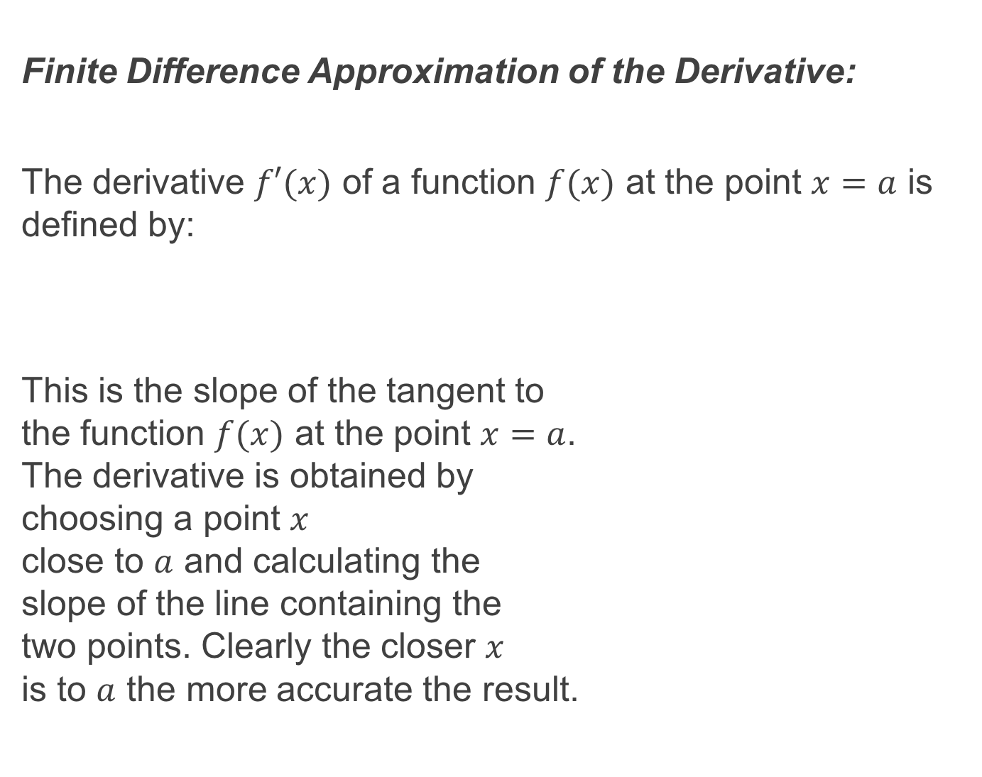
Finite Difference Approximation of the Derivative:
The derivative $f′(x)$ of a function $f(x)$ at the point $x=a$ is defined by:
This is the slope of the tangent to the function $f(x)$ at the point $x=a$. The derivative is obtained by choosing a point $x$ close to $a$ and calculating the slope of the line containing the two points. Clearly the closer $x$ is to $a$ the more accurate the result.

Slide 7
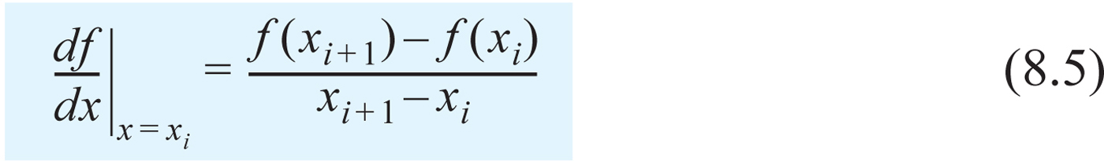
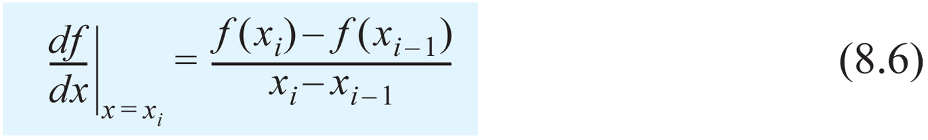
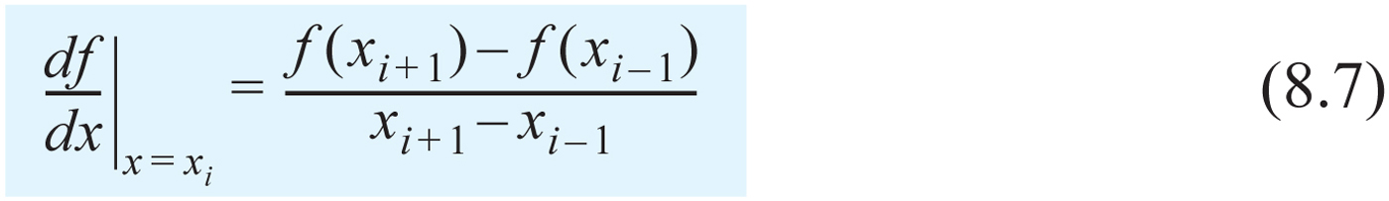
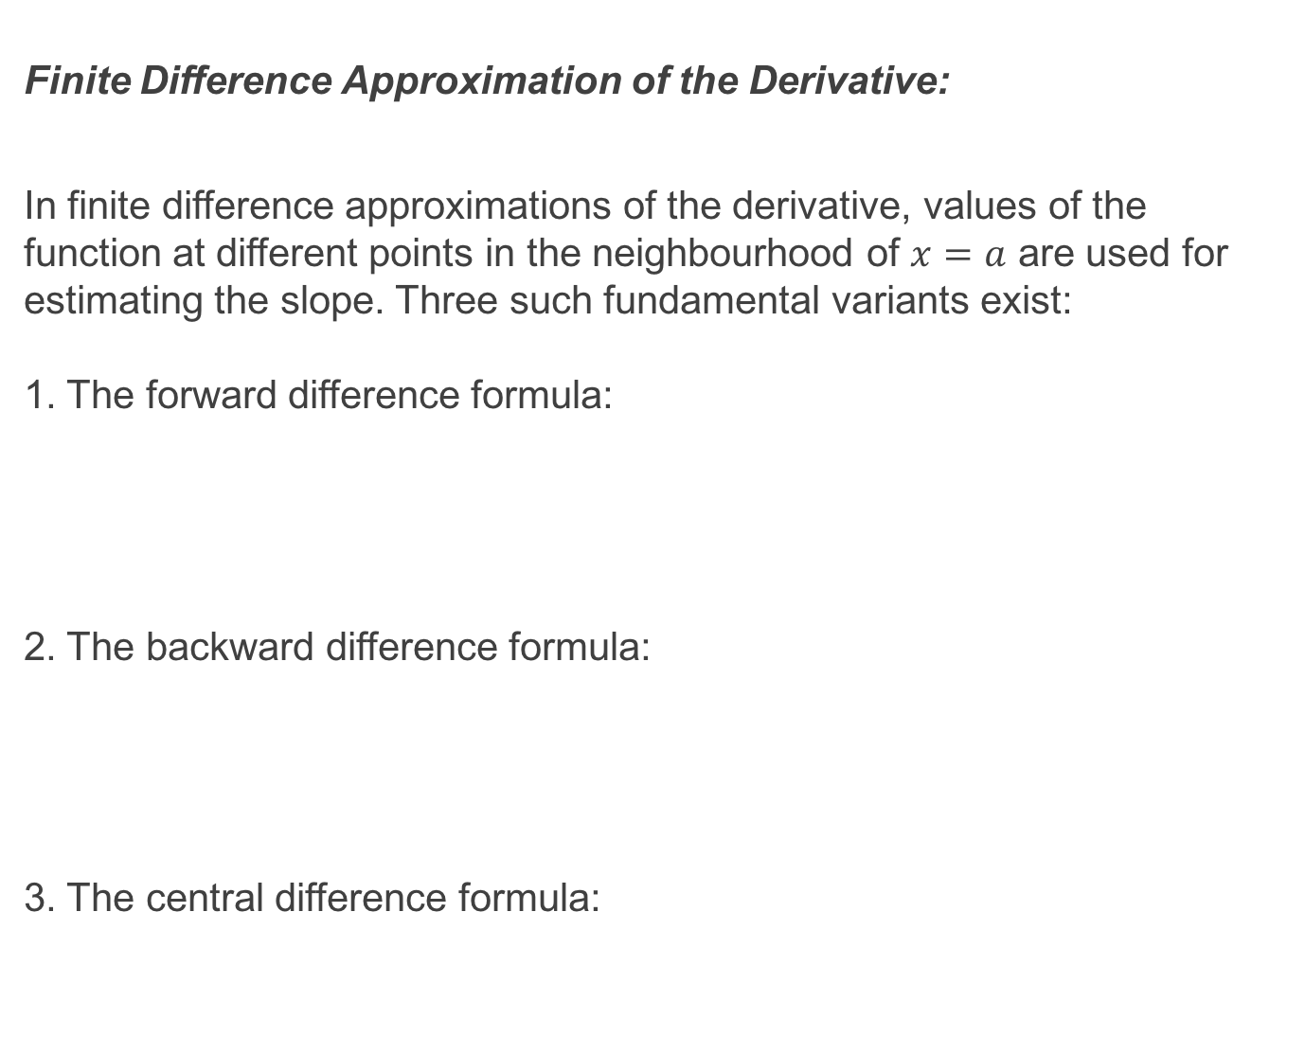
Finite Difference Approximation of the Derivative:
In finite difference approximations of the derivative, values of the function at different points in the neighbourhood of $x=a$ are used for estimating the slope. Three such fundamental variants exist: 1. The forward difference formula:
2. The backward difference formula:
3. The central difference formula:

Slide 8
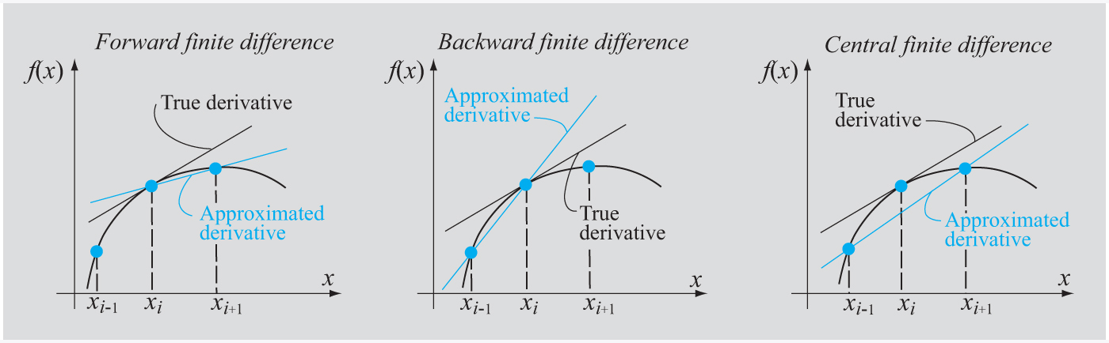
Finite Difference Approximation of the Derivative:
If the function is slowly varying then the central difference formula is usually the most accurate. That being said all are accurate if the spacings between the points are made very small.

Slide 9
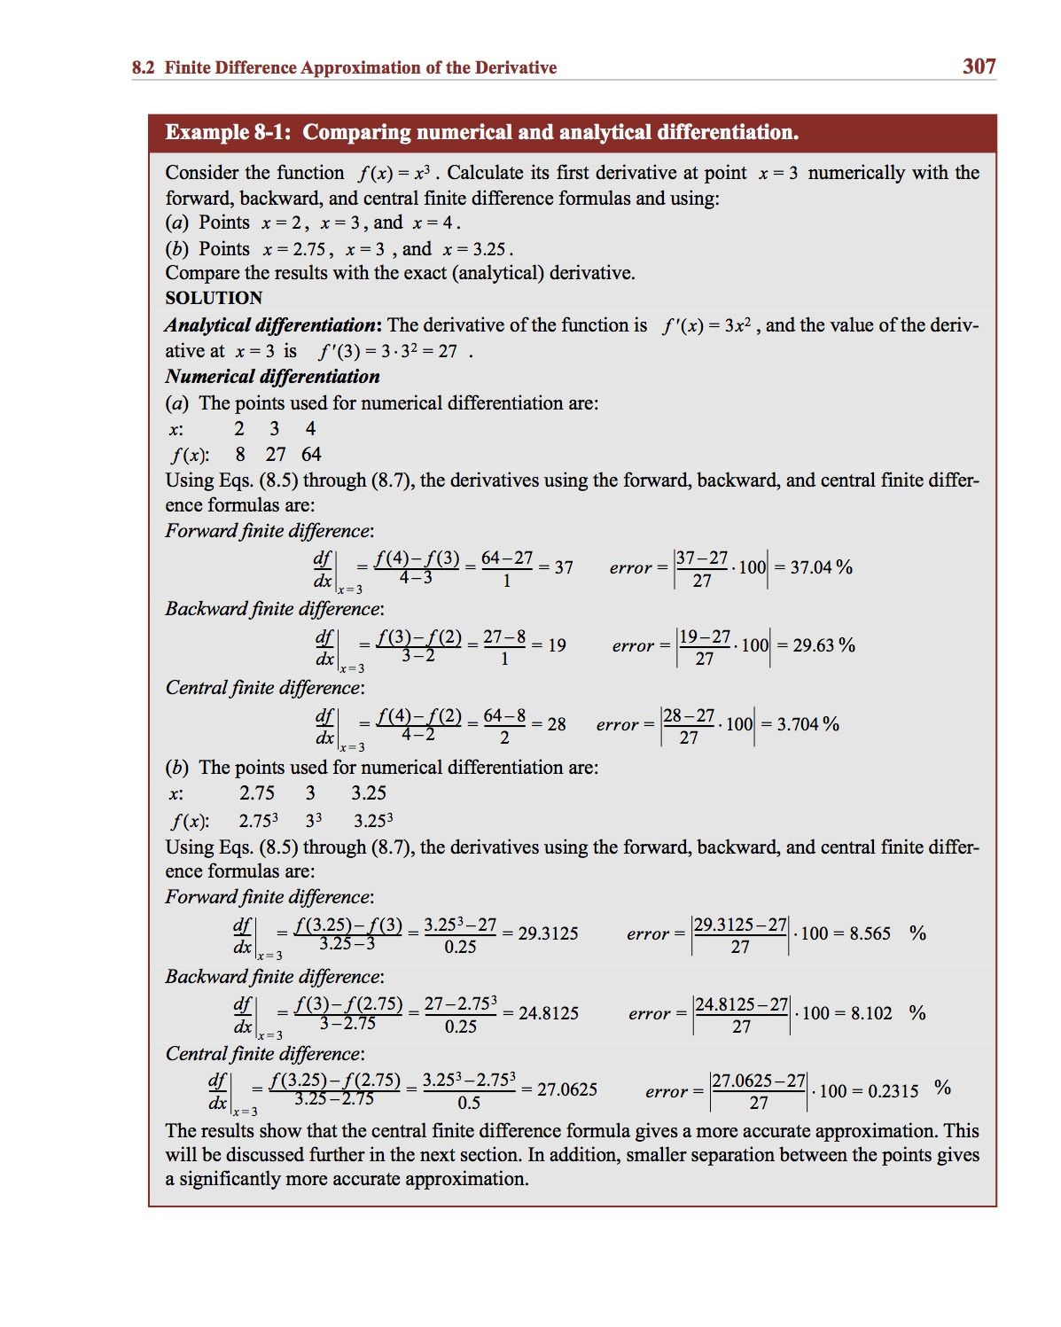
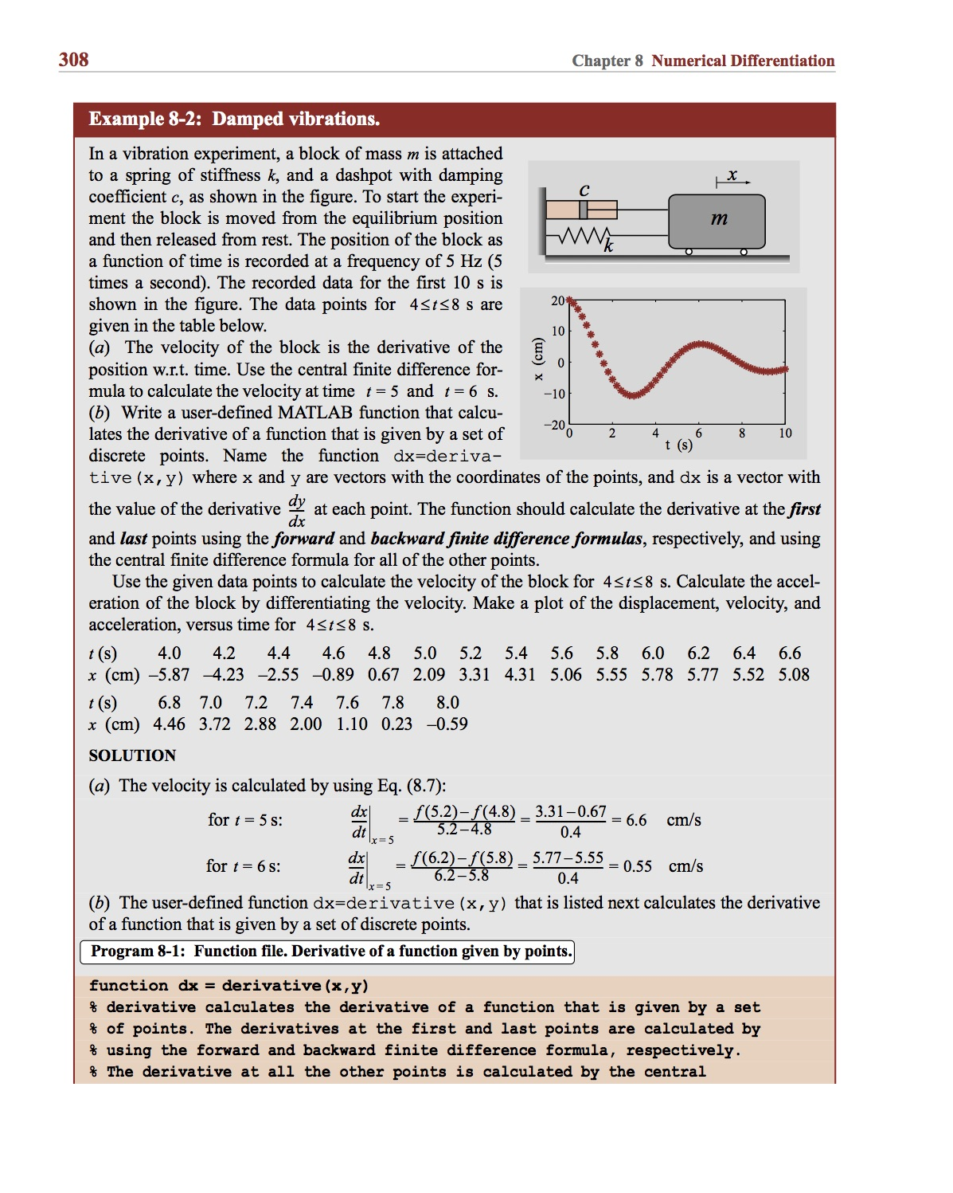
Example:

Slide 10
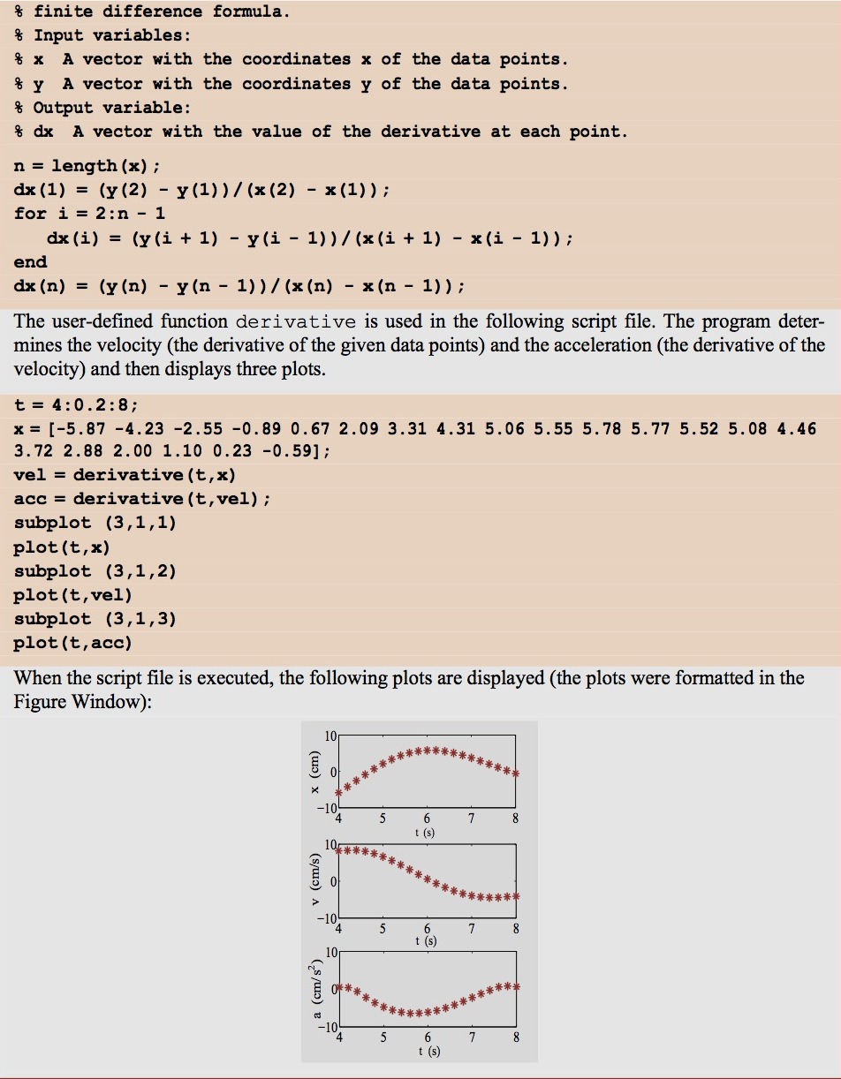
Example:

Slide 11
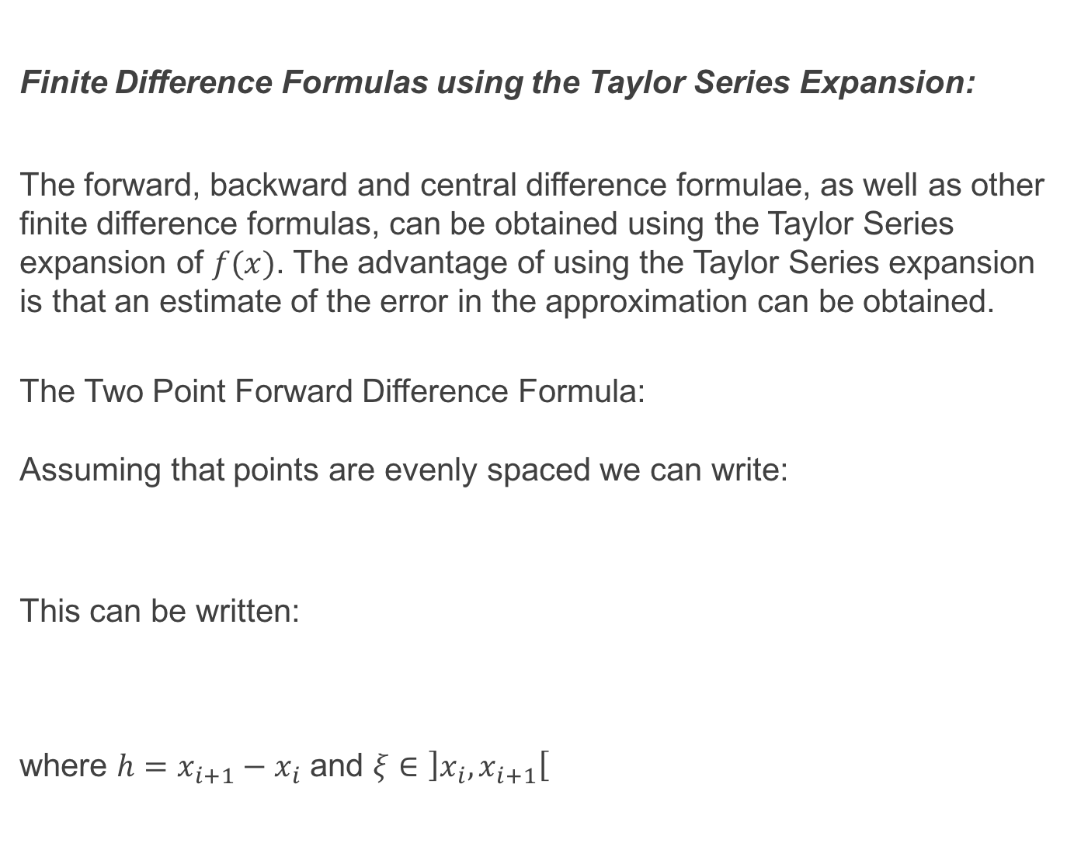
Finite Difference Formulas using the Taylor Series Expansion:
The forward, backward and central difference formulae, as well as other finite difference formulas, can be obtained using the Taylor Series expansion of $f(x)$. The advantage of using the Taylor Series expansion is that an estimate of the error in the approximation can be obtained.
The Two Point Forward Difference Formula: Assuming that points are evenly spaced we can write:
This can be written:
where $h=x_{i+1}−x_{i}$ and $ξ∈\left]x_{i}, x_{i+1}\right[$

Slide 12
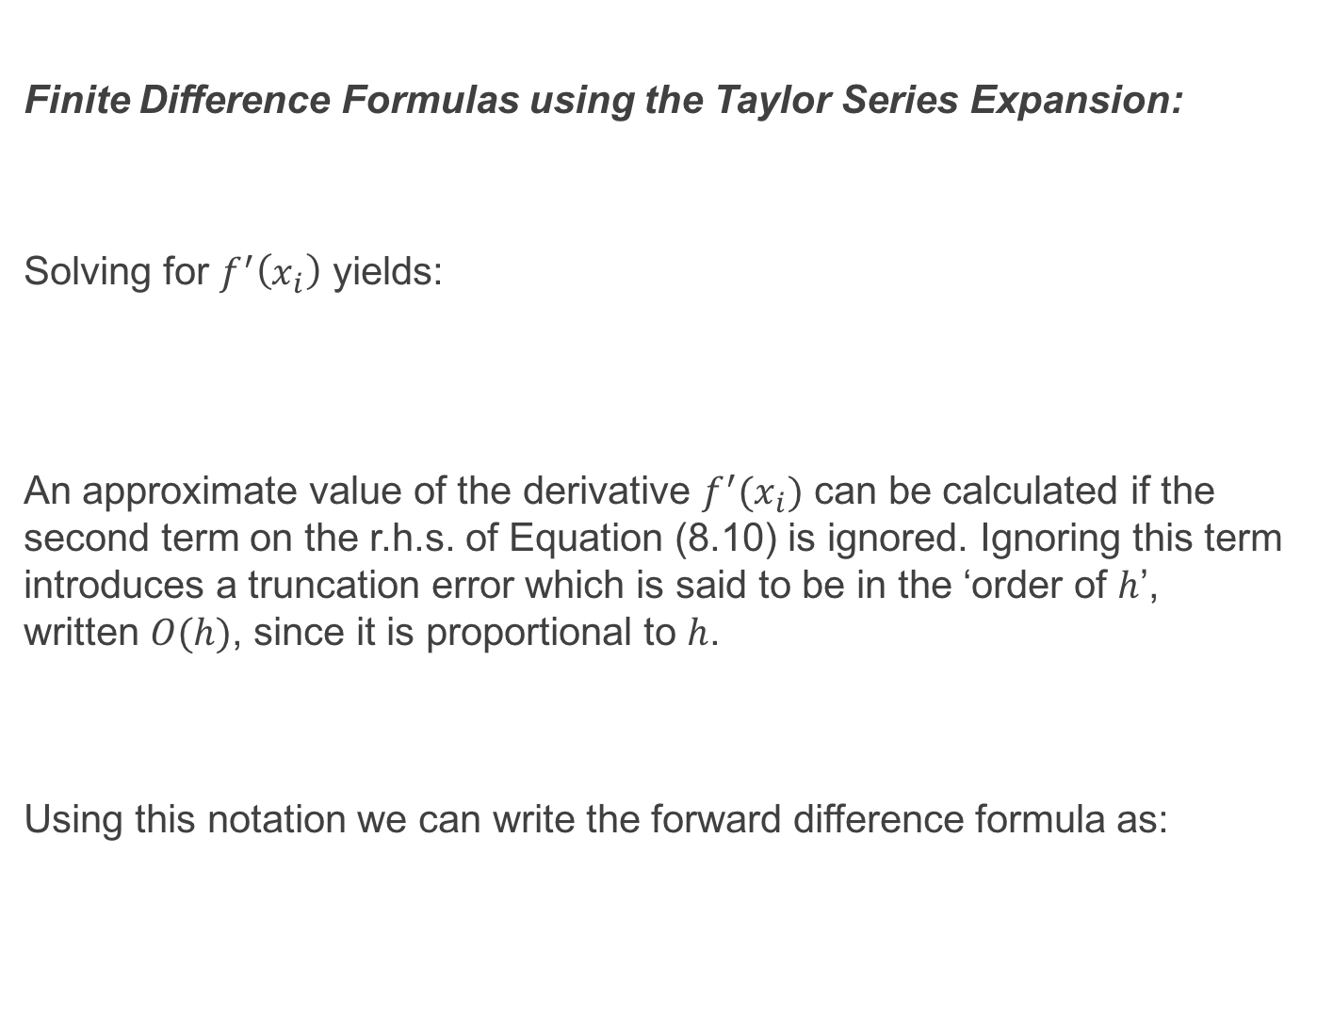
Finite Difference Formulas using the Taylor Series Expansion:
Solving for $f^{′}\left(x_{i}\right)$ yields:
An approximate value of the derivative $f^{′}(x_{i})$ can be calculated if the second term on the r.h.s. of Equation (8.10) is ignored. Ignoring this term introduces a truncation error which is said to be in the ‘order of $h$’, written $O(h)$, since it is proportional to $h$.
Using this notation we can write the forward difference formula as:

Slide 13
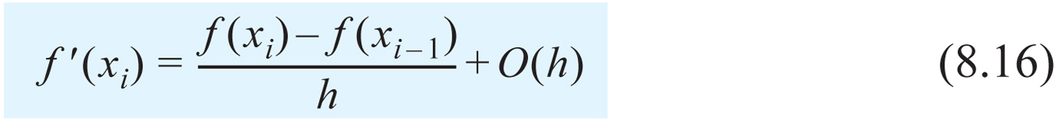
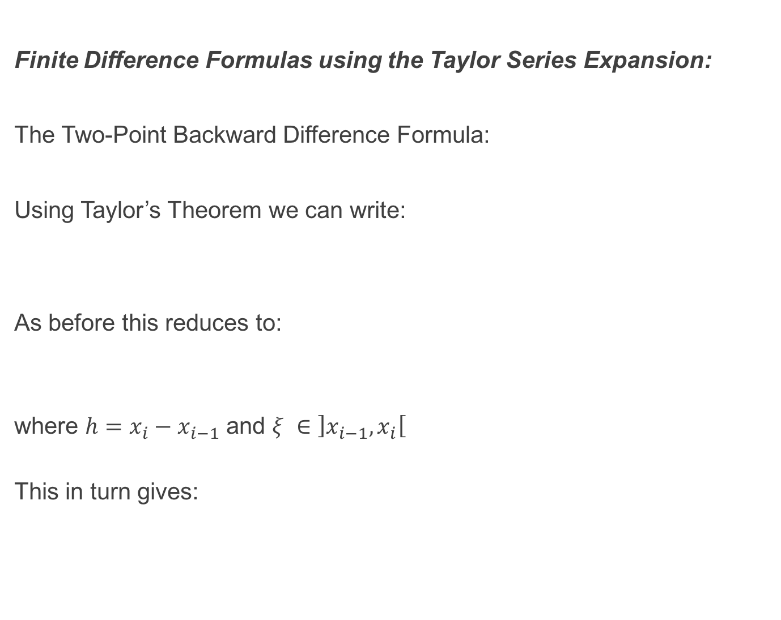
Finite Difference Formulas using the Taylor Series Expansion:
The Two-Point Backward Difference Formula:
Using Taylor’s Theorem we can write:
As before this reduces to:
where $h=x_{i}−x_{i−1}$ and $ξ ∈\left]x_{i−1}, x_{i}\right[$
This in turn gives:

Slide 14
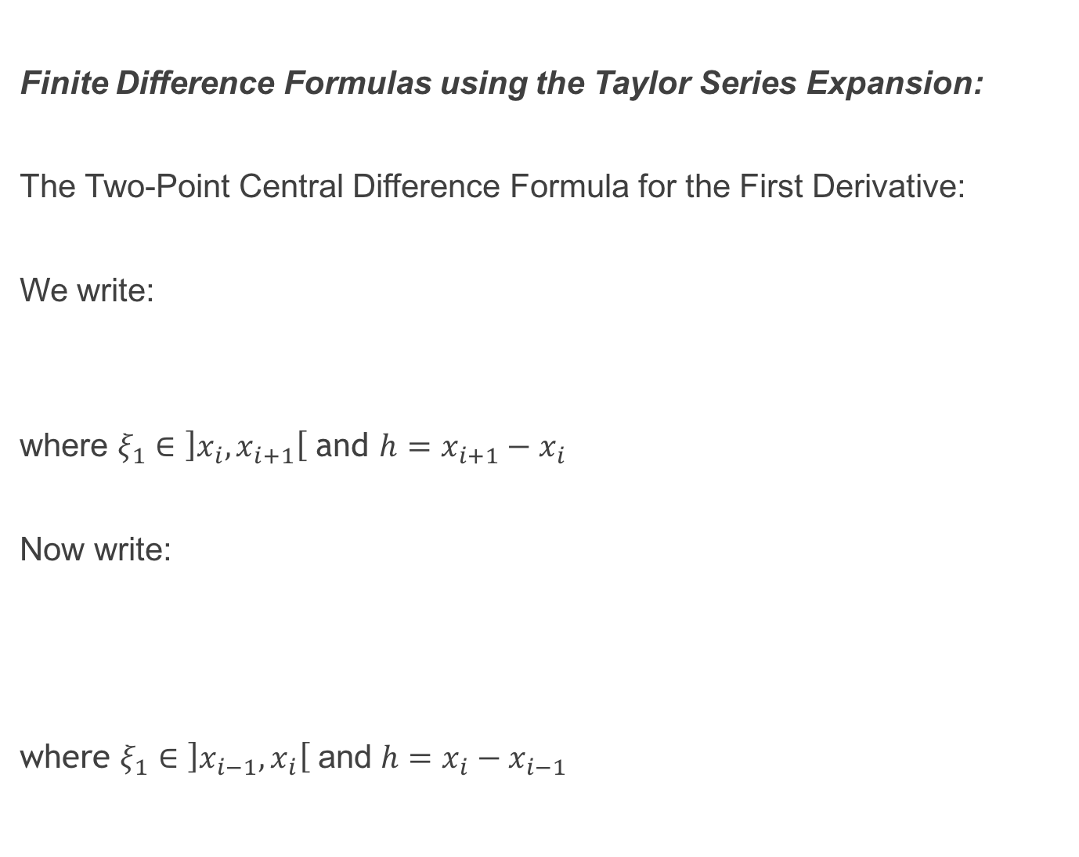
Finite Difference Formulas using the Taylor Series Expansion:
The Two-Point Central Difference Formula for the First Derivative:
We write:
where $ξ_{1}∈\left]x_{i}, x_{i+1}\right[$ and $h=x_{i+1}−x_{i}$
Now write:
where $ξ_{1}∈\left]x_{i−1}, x_{i}\right[$ and ${h=x}_{i}−x_{i−1}$

Slide 15
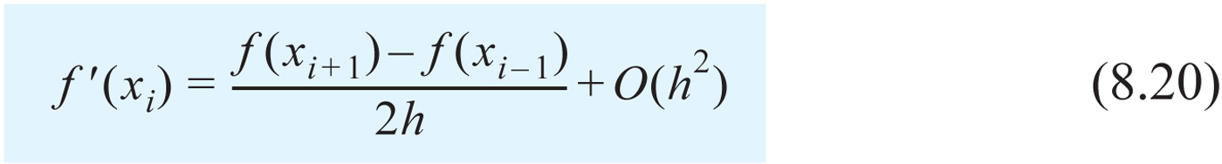
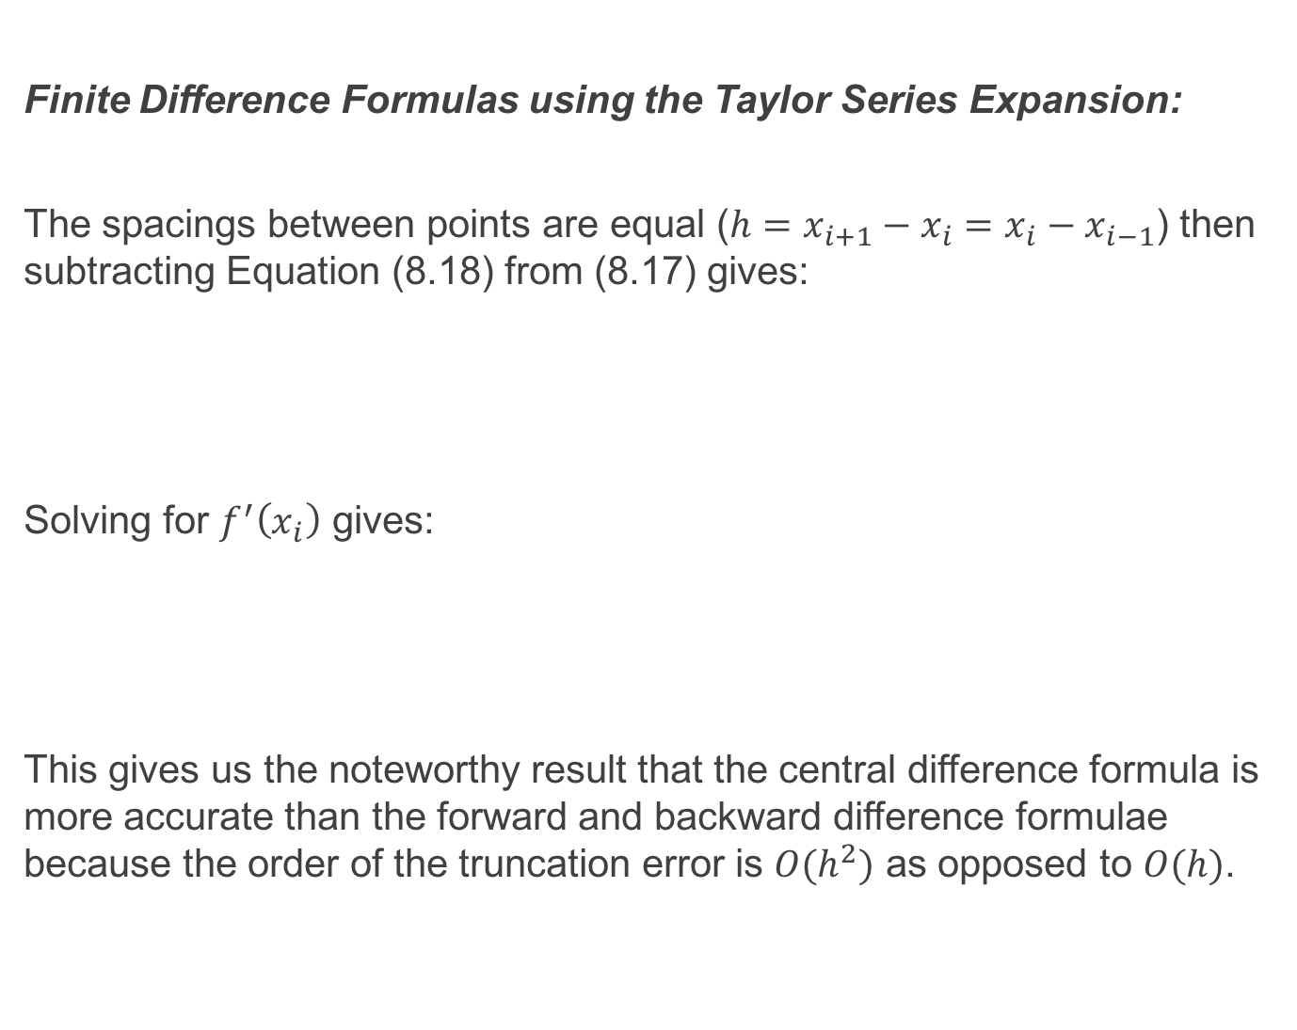
Finite Difference Formulas using the Taylor Series Expansion:
The spacings between points are equal ($h=x_{i+1}−x_{i}=x_{i}−x_{i−1}$) then subtracting Equation (8.18) from (8.17) gives:
Solving for $f^{′}\left(x_{i}\right)$ gives:
This gives us the noteworthy result that the central difference formula is more accurate than the forward and backward difference formulae because the order of the truncation error is $O(h^{2})$ as opposed to $O(h)$.

Slide 16
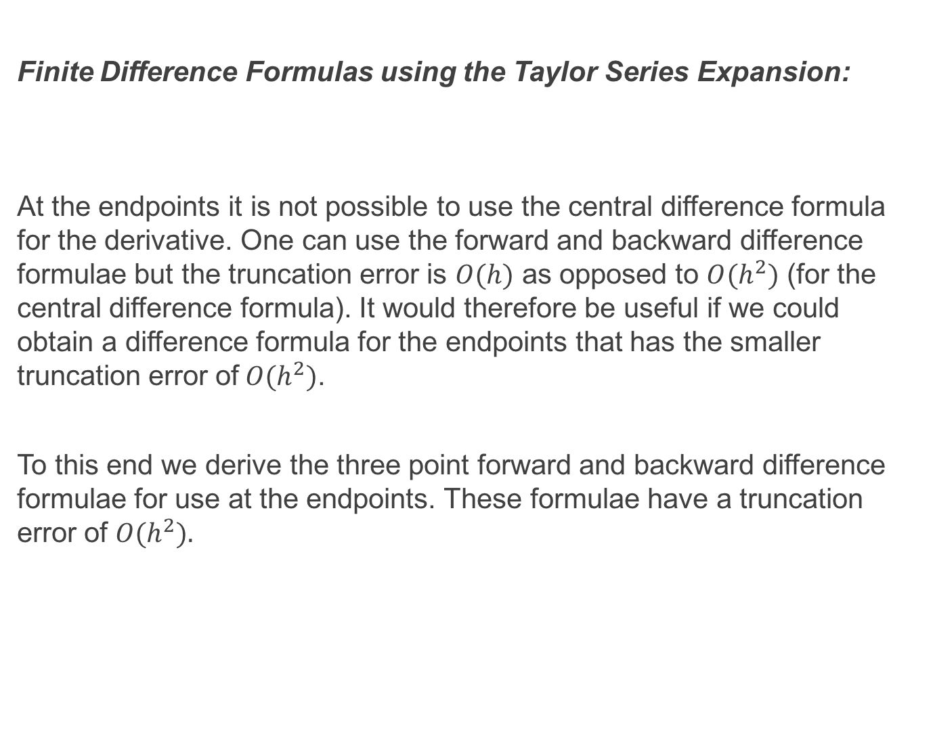
Finite Difference Formulas using the Taylor Series Expansion:
At the endpoints it is not possible to use the central difference formula for the derivative. One can use the forward and backward difference formulae but the truncation error is $O(h)$ as opposed to $O(h^{2})$ (for the central difference formula). It would therefore be useful if we could obtain a difference formula for the endpoints that has the smaller truncation error of$O(h^{2})$.
To this end we derive the three point forward and backward difference formulae for use at the endpoints. These formulae have a truncation error of $O(h^{2}).$

Slide 17
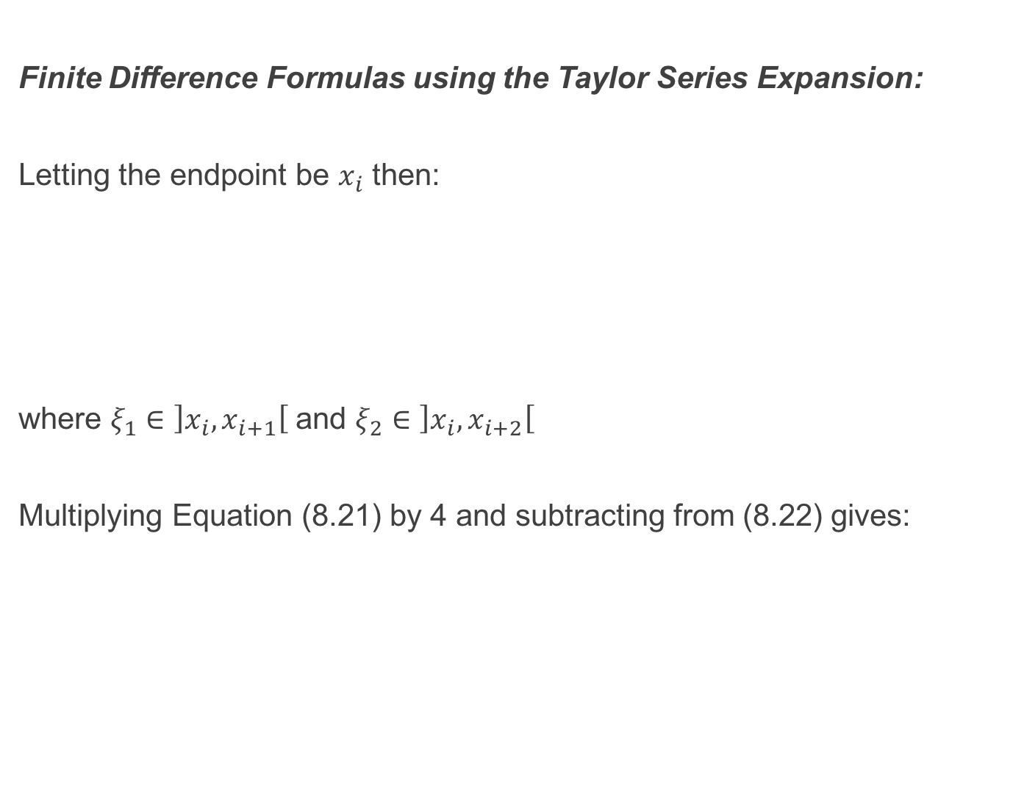
Finite Difference Formulas using the Taylor Series Expansion:
Letting the endpoint be $x_{i}$ then:
where $ξ_{1}∈\left]x_{i}, x_{i+1}\right[$ and $ξ_{2}∈\left]x_{i}, x_{i+2}\right[$
Multiplying Equation (8.21) by 4 and subtracting from (8.22) gives:

Slide 18
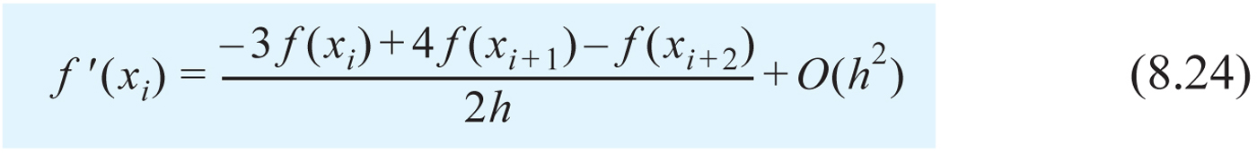
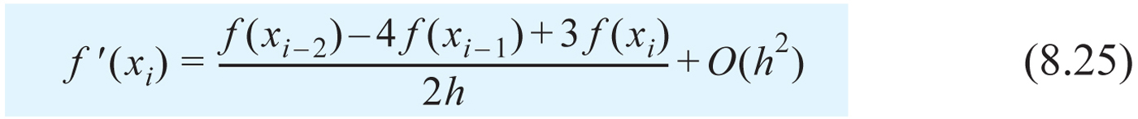
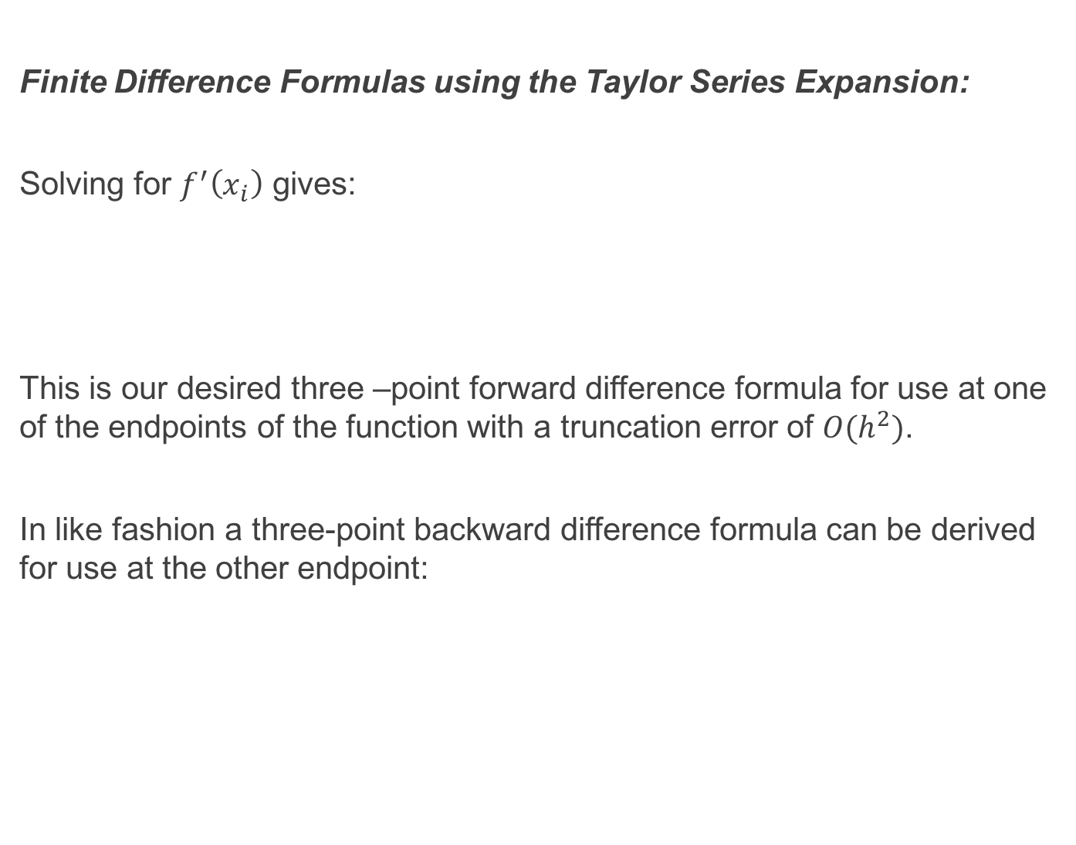
Finite Difference Formulas using the Taylor Series Expansion:
Solving for $f^{′}\left(x_{i}\right)$ gives:
This is our desired three –point forward difference formula for use at one of the endpoints of the function with a truncation error of $O(h^{2})$.
In like fashion a three-point backward difference formula can be derived for use at the other endpoint:

Slide 19
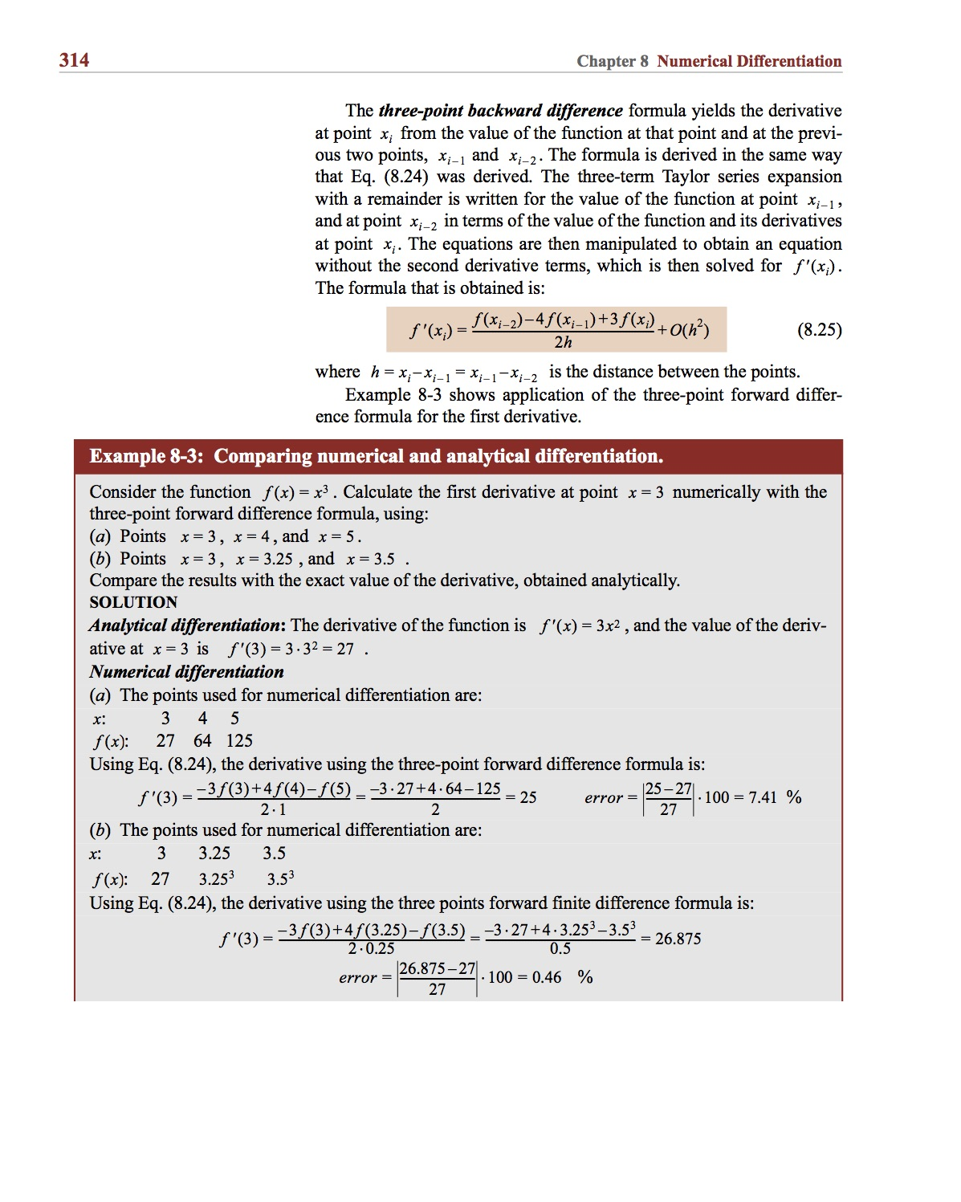
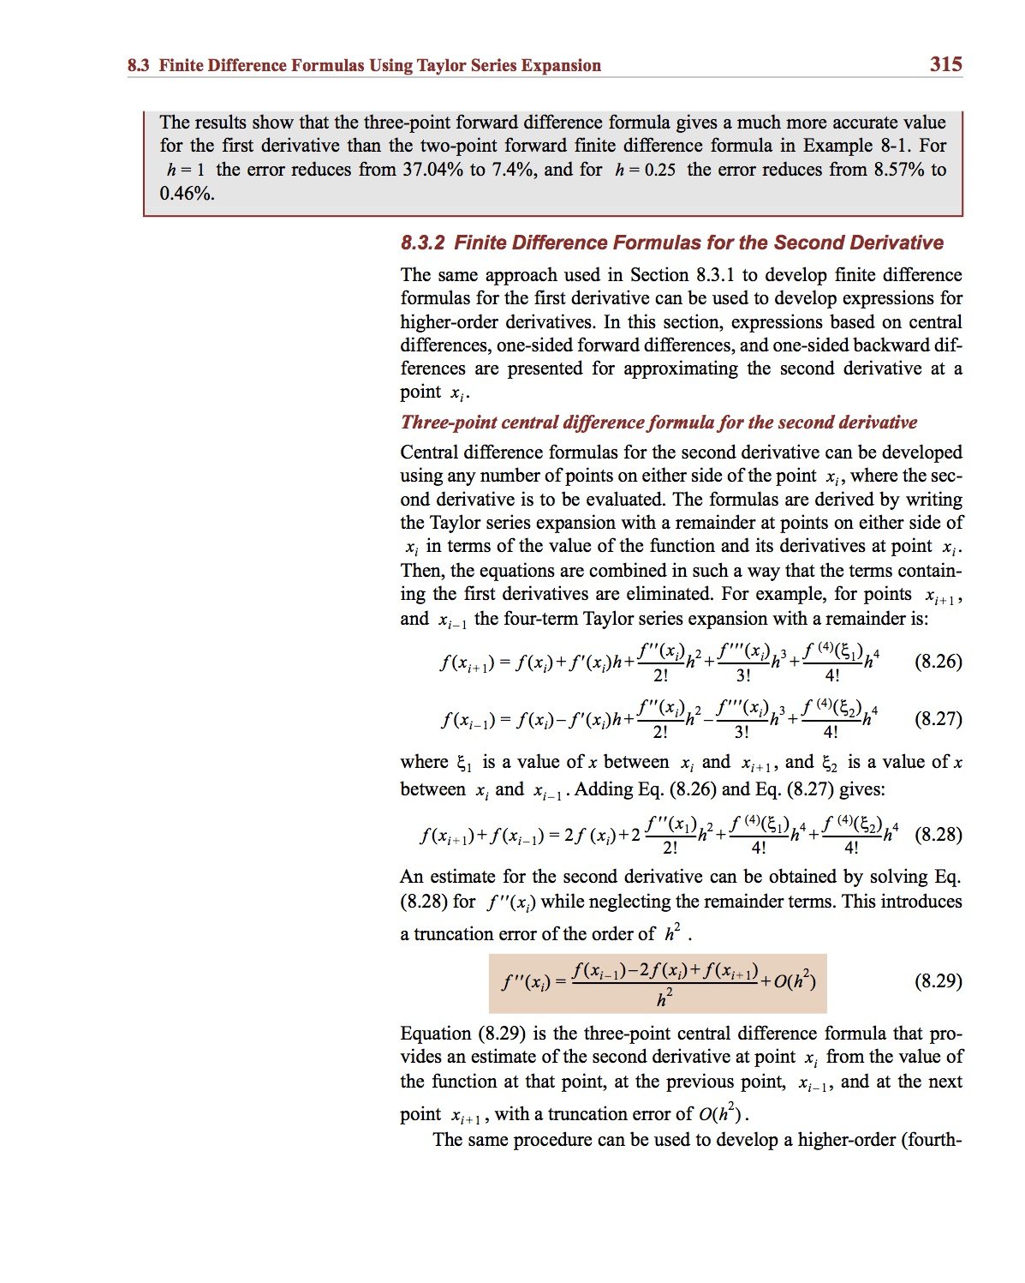
Example:

Slide 20
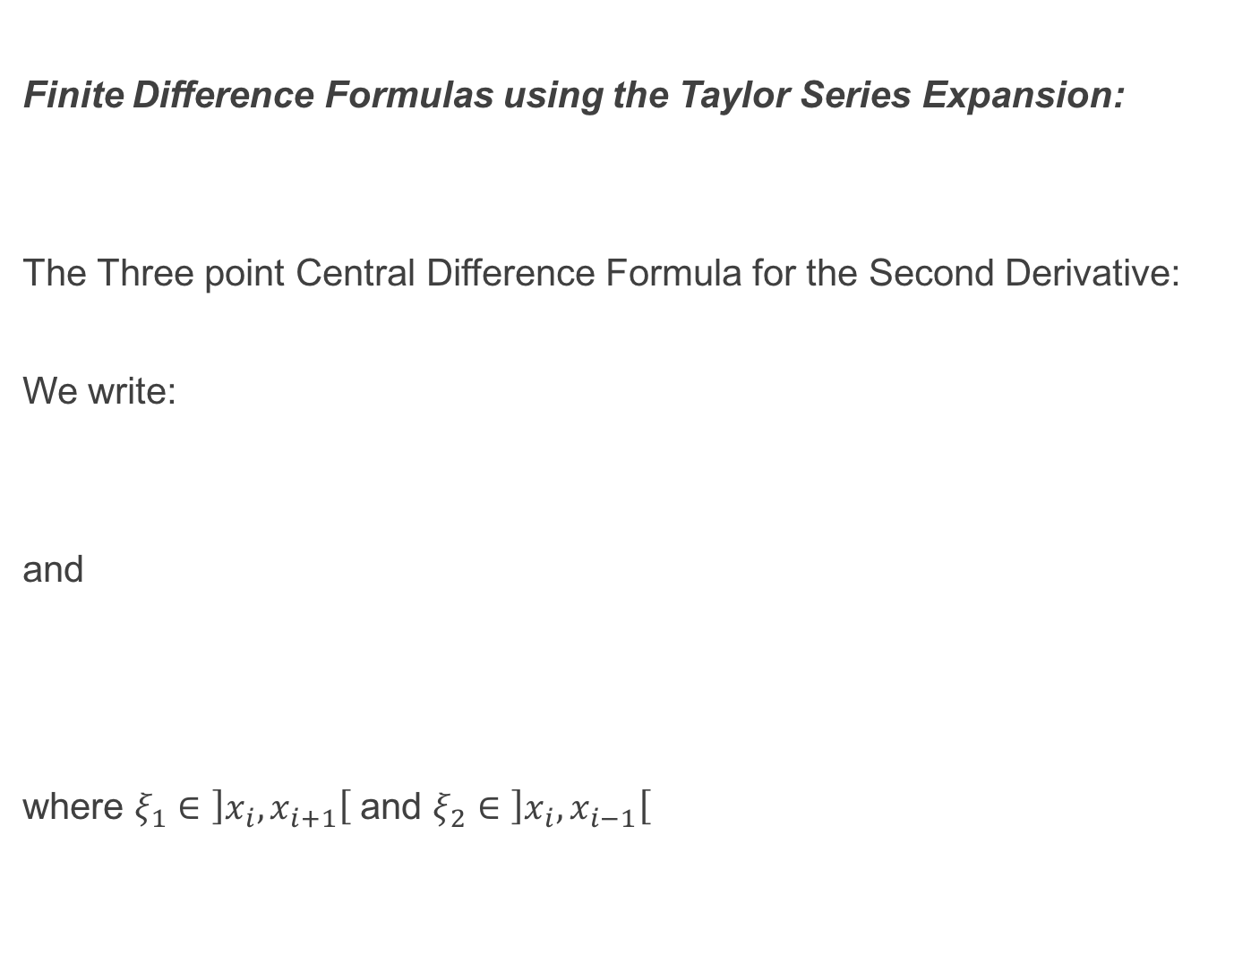
Finite Difference Formulas using the Taylor Series Expansion:
The Three point Central Difference Formula for the Second Derivative:
We write:
and
where $ξ_{1}∈\left]x_{i}, x_{i+1}\right[$ and $ξ_{2}∈\left]x_{i}, x_{i−1}\right[$

Slide 21
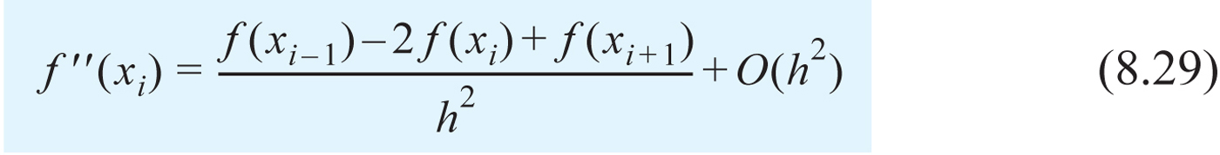
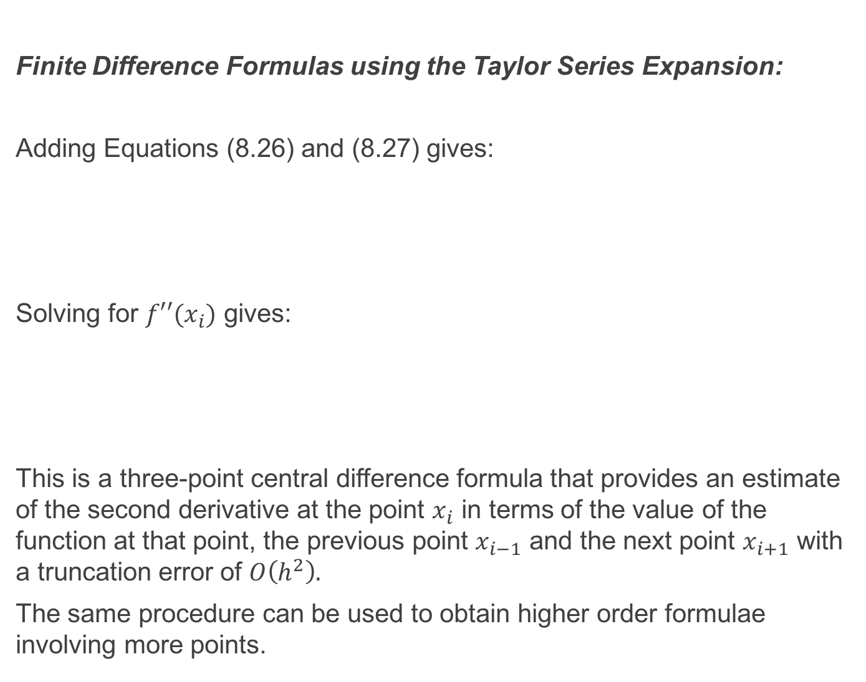
Finite Difference Formulas using the Taylor Series Expansion:
Adding Equations (8.26) and (8.27) gives:
Solving for $f′′(x_{i})$ gives:
This is a three-point central difference formula that provides an estimate of the second derivative at the point $x_{i}$ in terms of the value of the function at that point, the previous point $x_{i−1}$ and the next point $x_{i+1}$ with a truncation error of $O\left(h^{2}\right).$
The same procedure can be used to obtain higher order formulae involving more points.

Slide 22
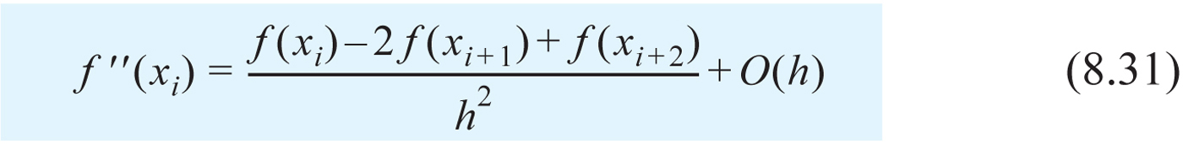
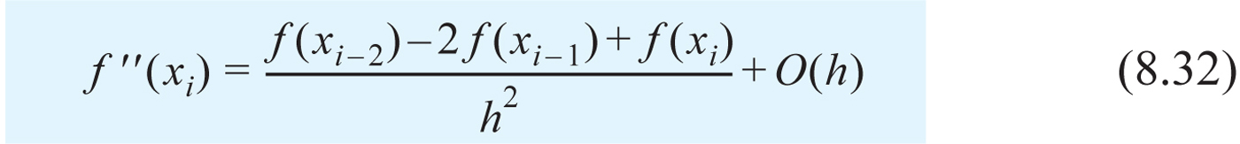
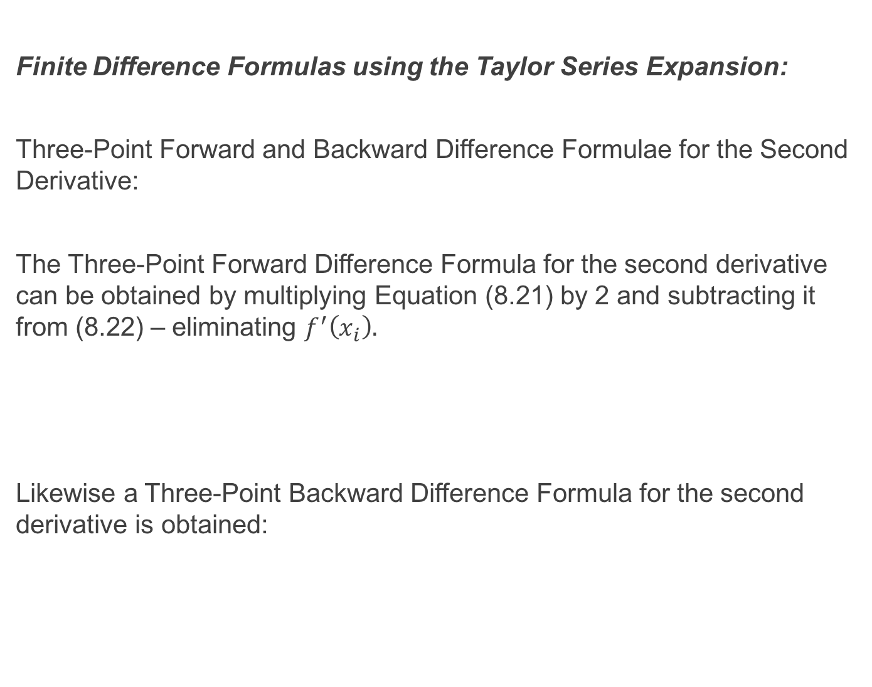
Finite Difference Formulas using the Taylor Series Expansion:
Three-Point Forward and Backward Difference Formulae for the Second Derivative:
The Three-Point Forward Difference Formula for the second derivative can be obtained by multiplying Equation (8.21) by 2 and subtracting it from (8.22) – eliminating $f^{′}\left(x_{i}\right).$
Likewise a Three-Point Backward Difference Formula for the second derivative is obtained:

Slide 23
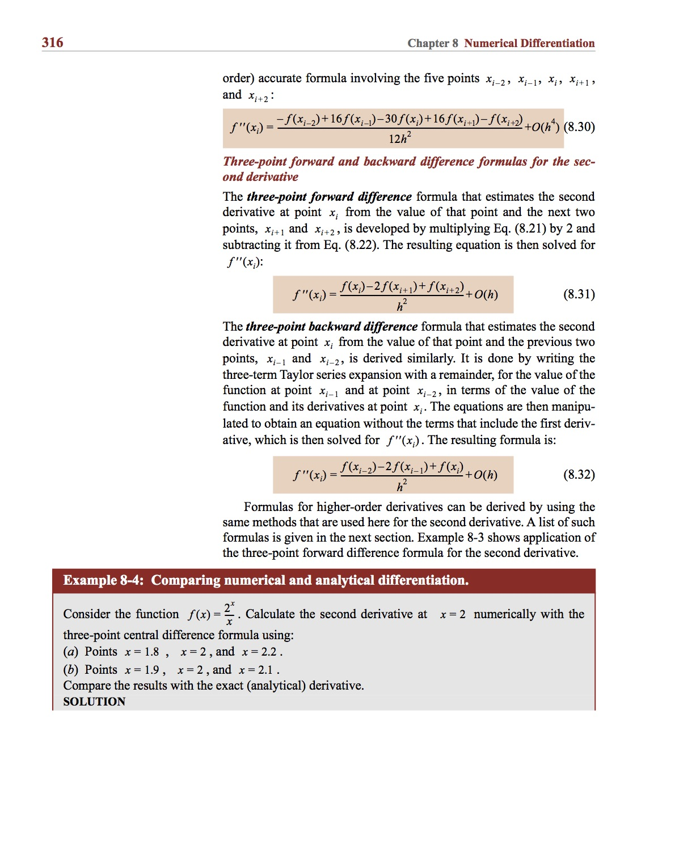
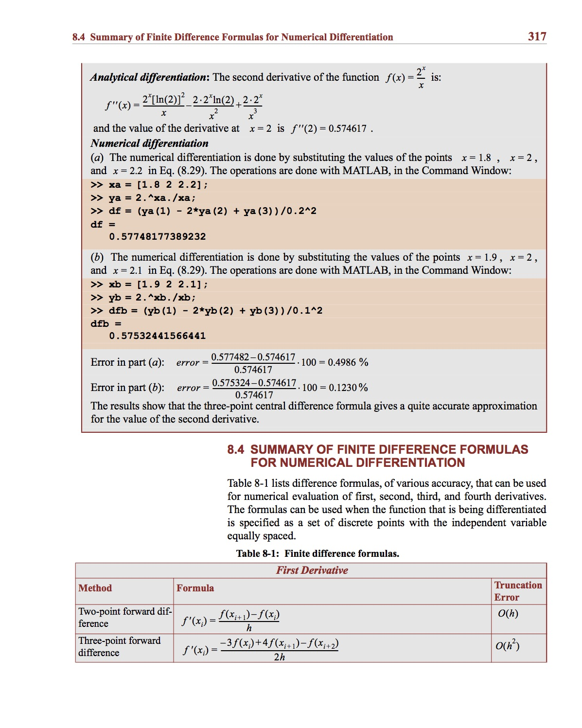
Example:

Slide 24
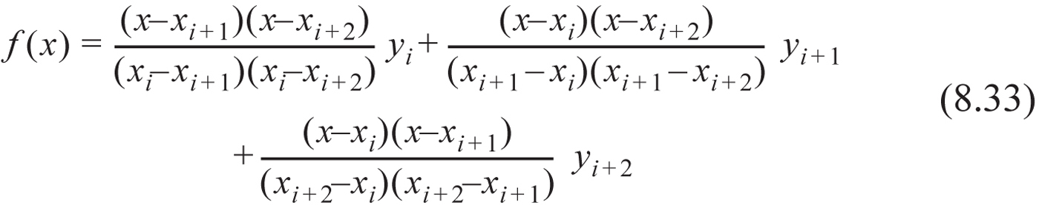
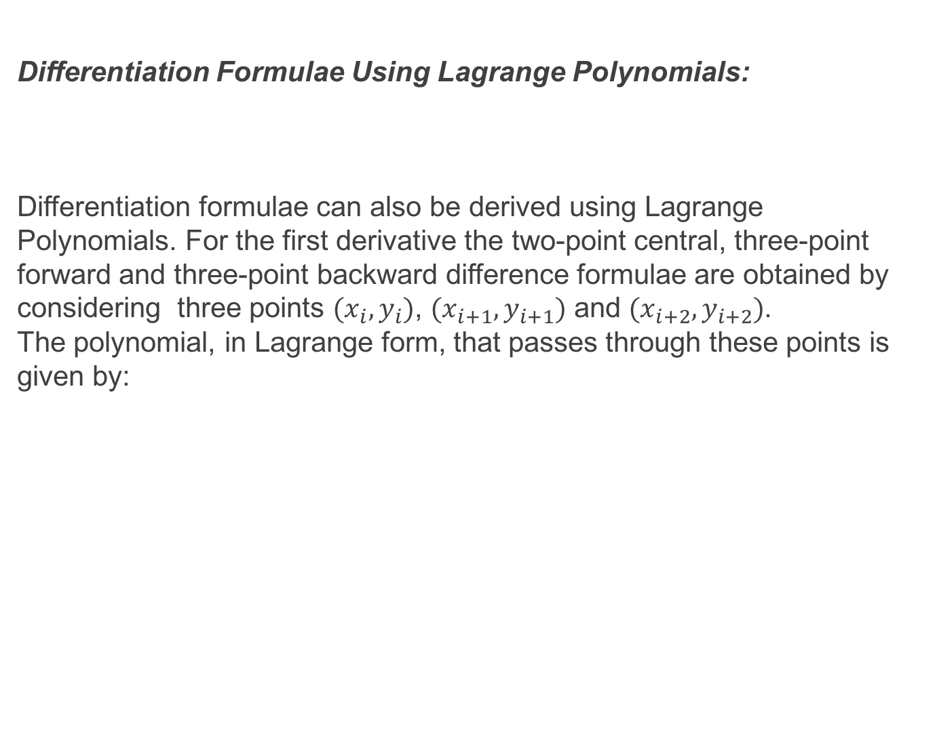
Differentiation Formulae Using Lagrange Polynomials:
Differentiation formulae can also be derived using Lagrange Polynomials. For the first derivative the two-point central, three-point forward and three-point backward difference formulae are obtained by considering three points $(x_{i}, y_{i})$, $(x_{i+1}, y_{i+1})$ and $(x_{i+2}, y_{i+2})$. The polynomial, in Lagrange form, that passes through these points is given by:

Slide 25
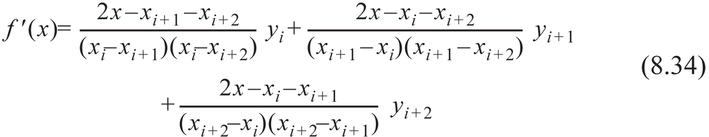
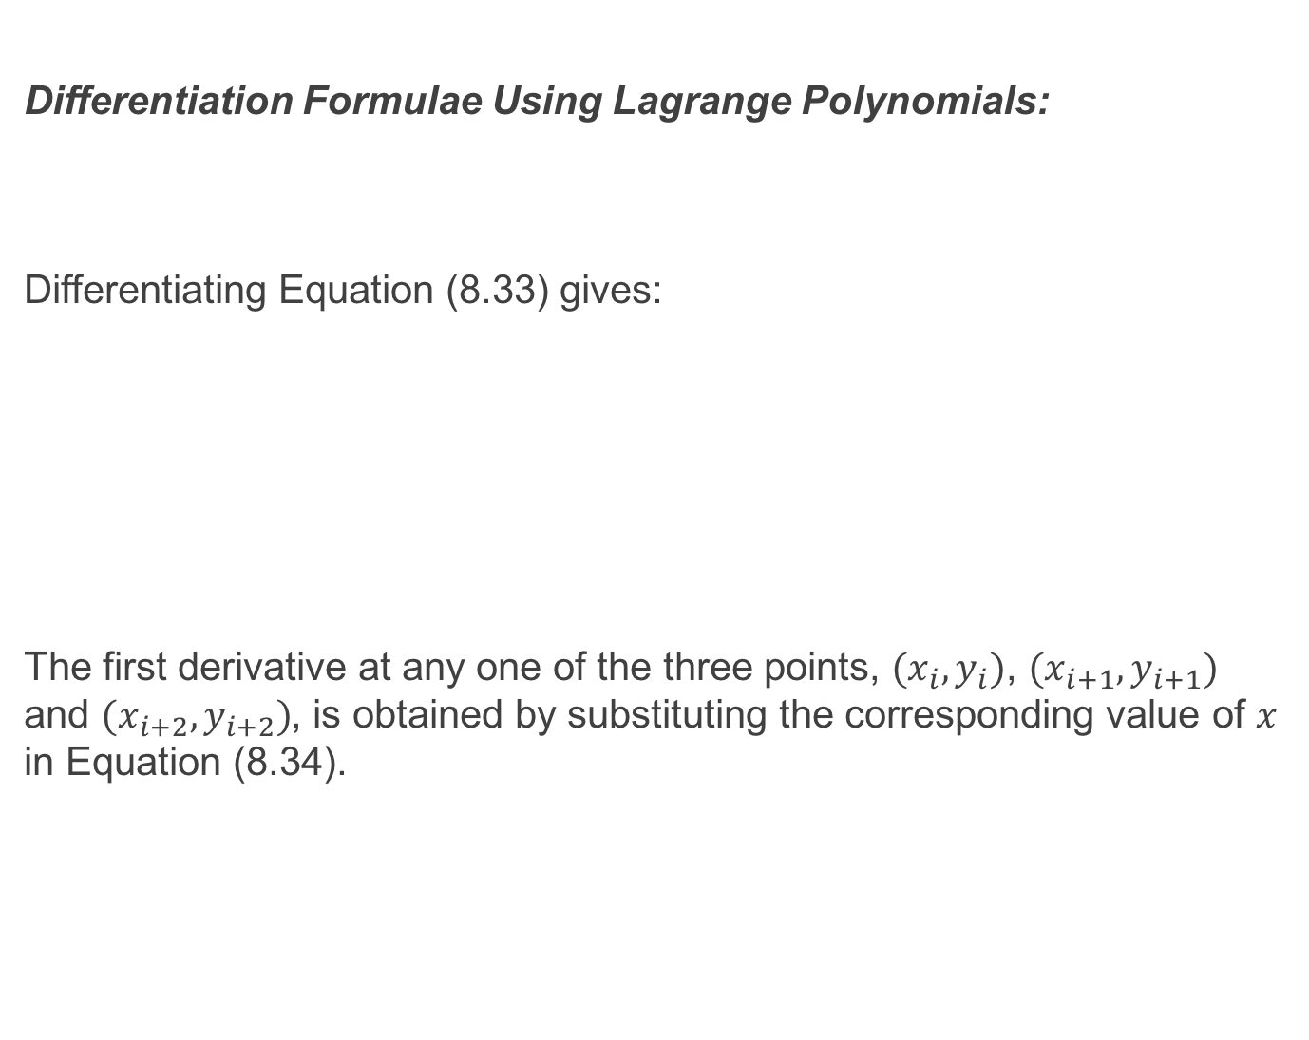
Differentiation Formulae Using Lagrange Polynomials:
Differentiating Equation (8.33) gives:
The first derivative at any one of the three points, $(x_{i}, y_{i})$, $(x_{i+1}, y_{i+1})$ and $(x_{i+2}, y_{i+2})$, is obtained by substituting the corresponding value of $x$ in Equation (8.34).

Slide 26

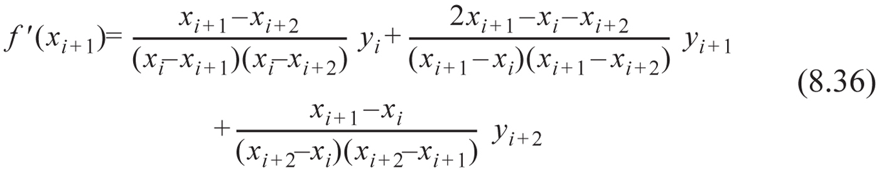
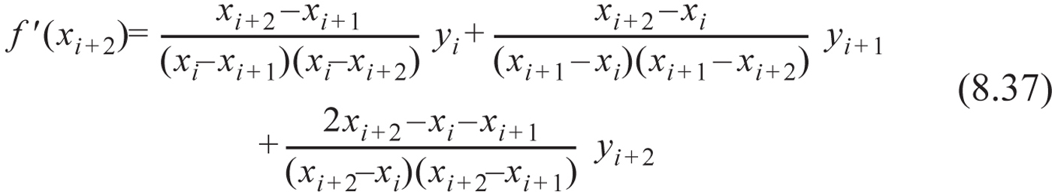
Differentiation Formulae Using Lagrange Polynomials:
These are the three-point forward difference, two-point central difference and three point backward difference formulae respectively. The advantage of these formulae is that points do not have to be evenly spaced. However there is no estimate for the magnitude of the error.

Slide 27
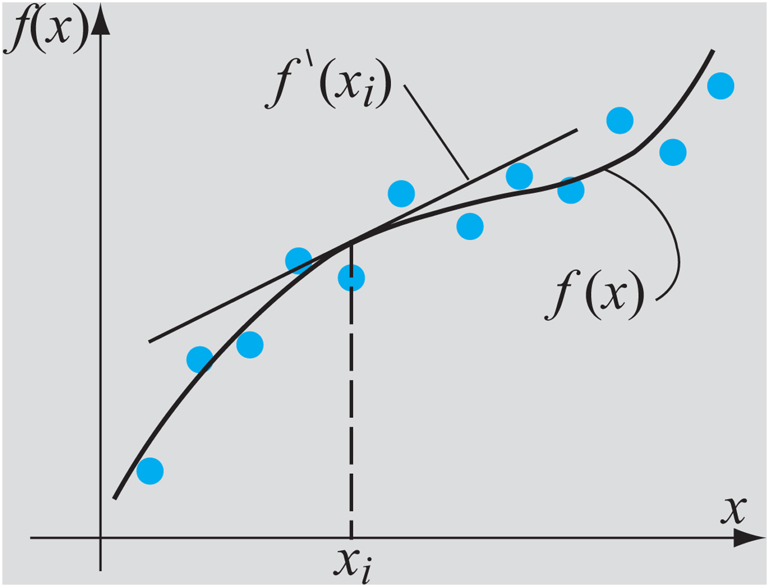
Differentiation using Curve Fitting:
Differentiation may also be performed by finding an analytic function that approximates the data. The value of the derivative at a point can then be found by differentiating analytically. This procedure is preferred if there is a lot of scatter in the data. Curve fitting smooths out the scatter and so enhances the accuracy of the estimate of the derivative. Again however, unlike using finite difference formulae using the Taylor Series expansion there is no error estimate.

Slide 28
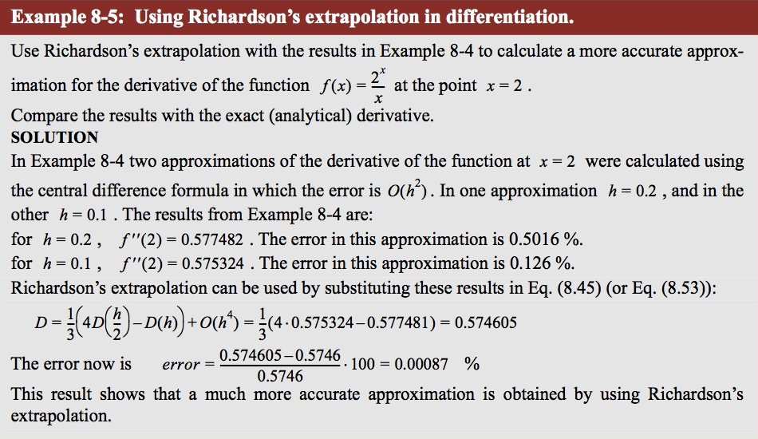
Example:

Slide 29
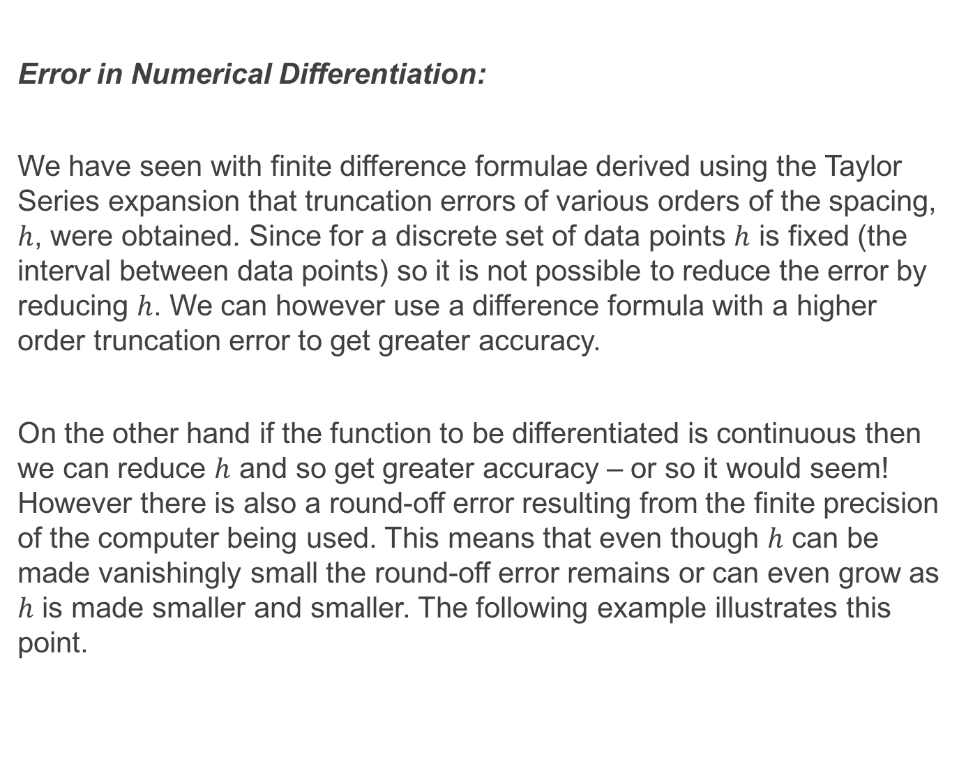
Error in Numerical Differentiation:
We have seen with finite difference formulae derived using the Taylor Series expansion that truncation errors of various orders of the spacing, $h$, were obtained. Since for a discrete set of data points $h$ is fixed (the interval between data points) so it is not possible to reduce the error by reducing $h$. We can however use a difference formula with a higher order truncation error to get greater accuracy.
On the other hand if the function to be differentiated is continuous then we can reduce $h$ and so get greater accuracy – or so it would seem! However there is also a round-off error resulting from the finite precision of the computer being used. This means that even though $h$ can be made vanishingly small the round-off error remains or can even grow as $h$ is made smaller and smaller. The following example illustrates this point.

Slide 30
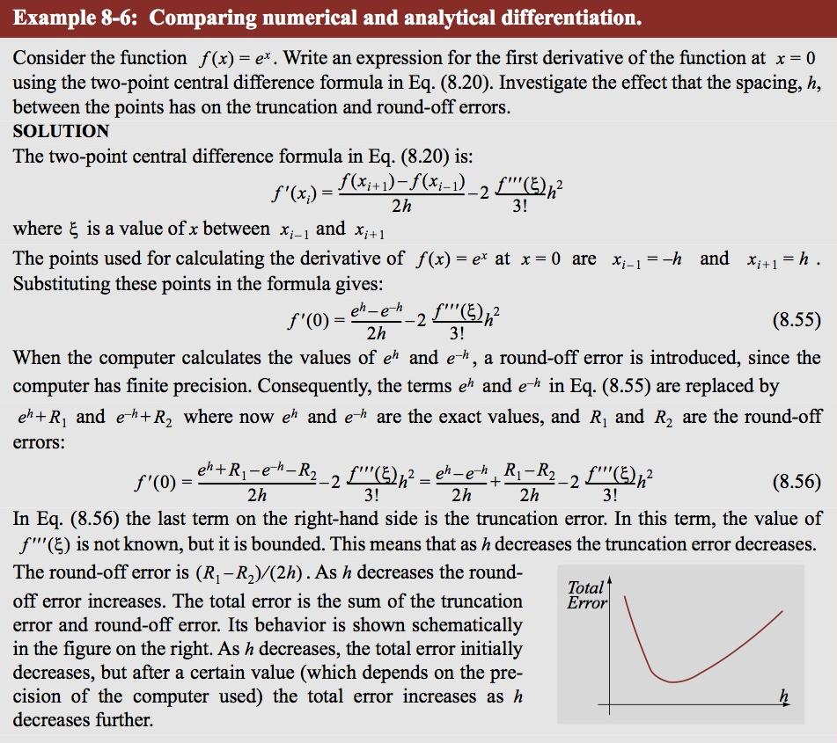
Example:

Slide 31
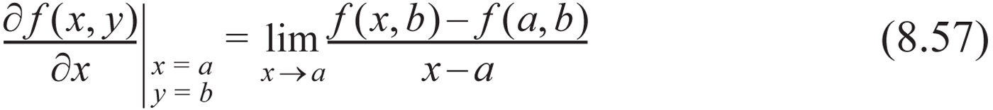
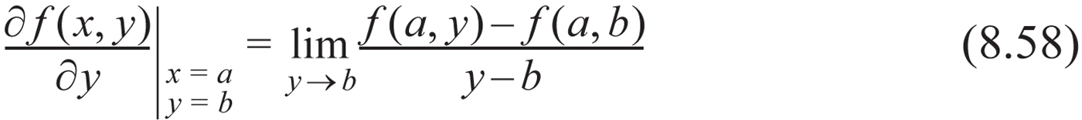

Numerical Partial Differentiation:
The finite difference formulae obtained earlier can also be used to obtain partial derivatives. For a function $f(x, y)$ the partial derivatives with respect to $x$ and $y$ at that point $(a, b)$ are:
This means that the finite difference formulae for functions of a single variable can be extended to calculating the partial derivatives with respect to a particular variable of functions of two or more independent variables simply by holding the other variables constant.

Slide 32




Numerical Partial Differentiation:
For example an approximation for the partial derivative at the point $\left(x_{i}, y_{i}\right)$ with the two-point forward difference formula is:

Slide 33




Numerical Partial Differentiation:
In the same way the two-point backward and central difference formulae are:
The second partial derivatives with the three-point central difference formulae are:

Slide 34

Numerical Partial Differentiation :
The second order partial derivative can also be mixed:
$\frac{δ^{2}f}{δxδy}= \frac{δ}{δy}\left(\frac{δf}{δx}\right)== \frac{δ}{δx}\left(\frac{δf}{δy}\right)$
A finite difference formula for the mixed derivative can be obtained by using the first-order finite difference formulae for partial derivatives.

Slide 35


Example:

Slide 36
Recommended Problems:
Problems to be solved by hand (do at least 1):
8.3, 8.8, 8.9
Problems to be programmed in MATLAB:
8.19
Problems in Science and Engineering (do at least 1):
8.31, 8.37
You should pick out problems that you find interesting/challenging and do these too.

